Slide 1




DEEP LEARNING
FOR
LIVER SEGMENTATION
GUIDE:
Prof. Siddique Ibrahim Peer Mohamed
Name
Reg. no
Sirasanagandla Madhuri
21BCE8217
Chigurupati Amarnath
21BCE8893
Ankit Kommalapati
21BCE8228

Slide 2
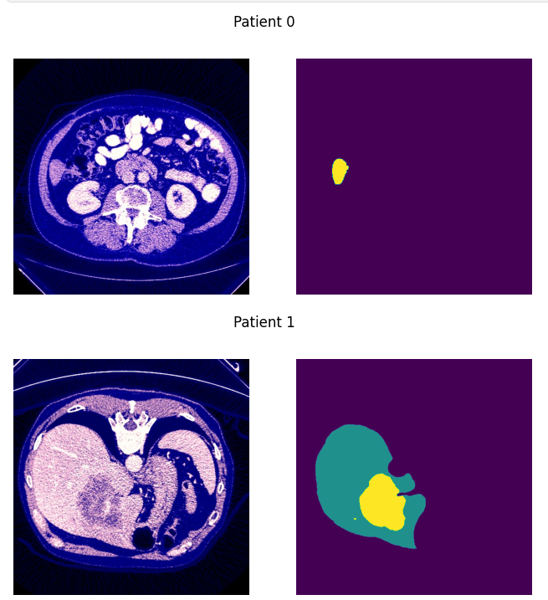
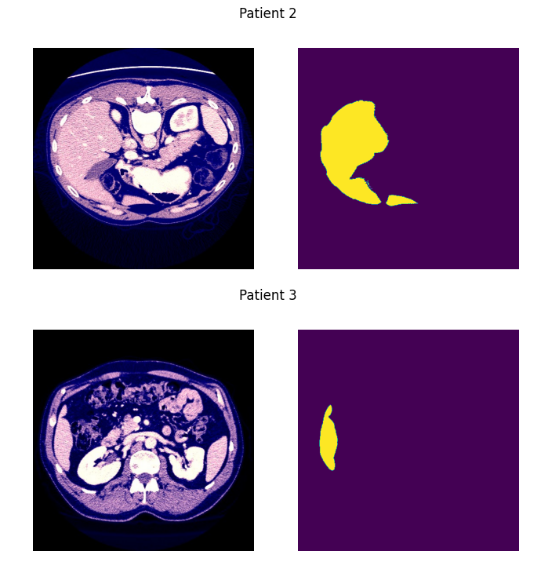
INPUT CT SCAN AND ITS LABEL

Slide 3
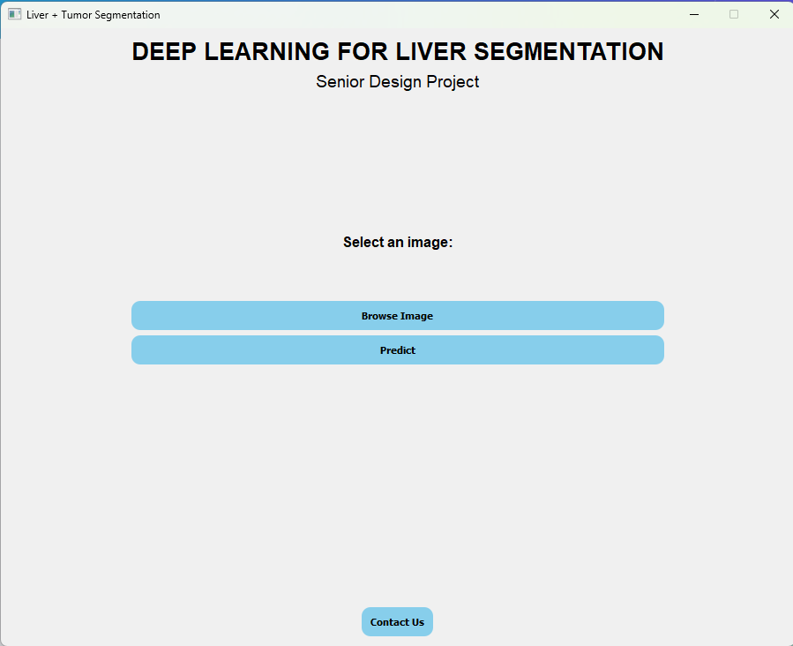
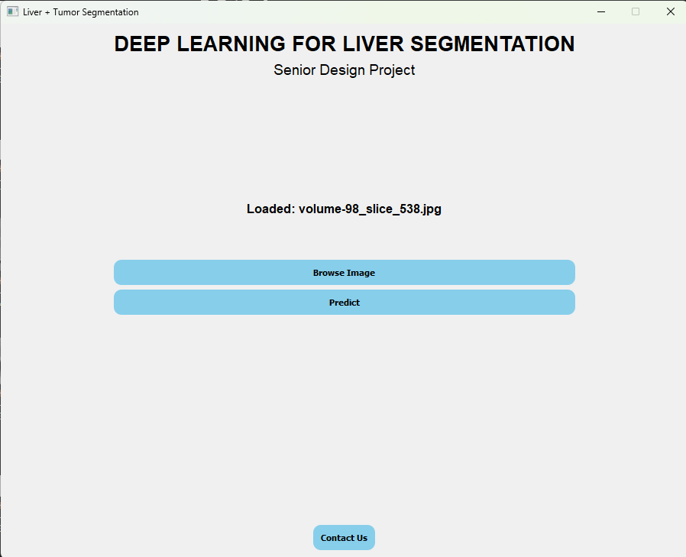
GUI

Slide 4
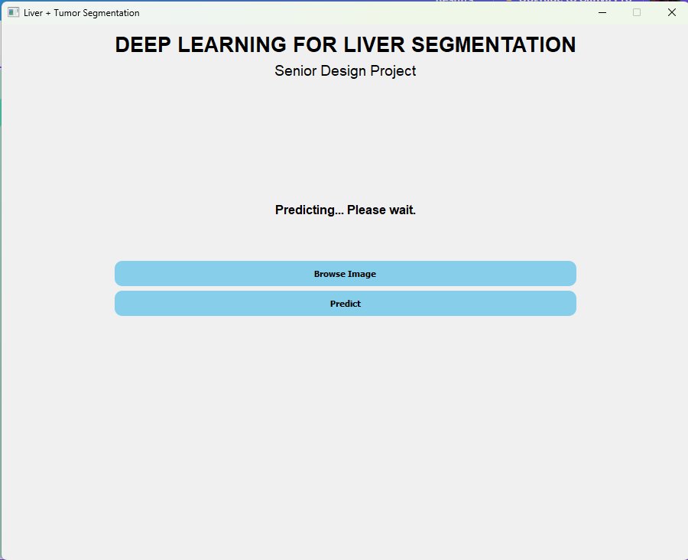
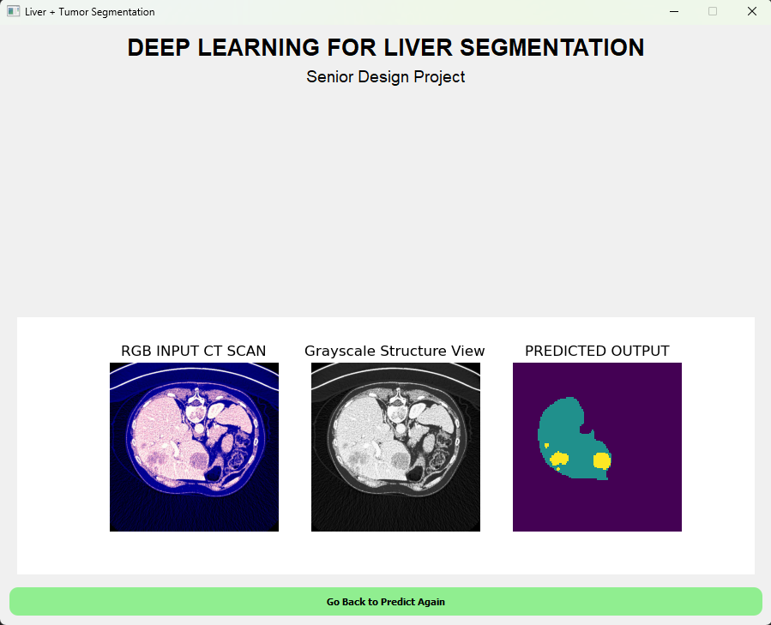
output

Slide 5
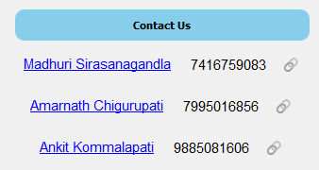
A contact us page with the names phone number and linkedin links so that users can have a quick talk regarding the project

Slide 6
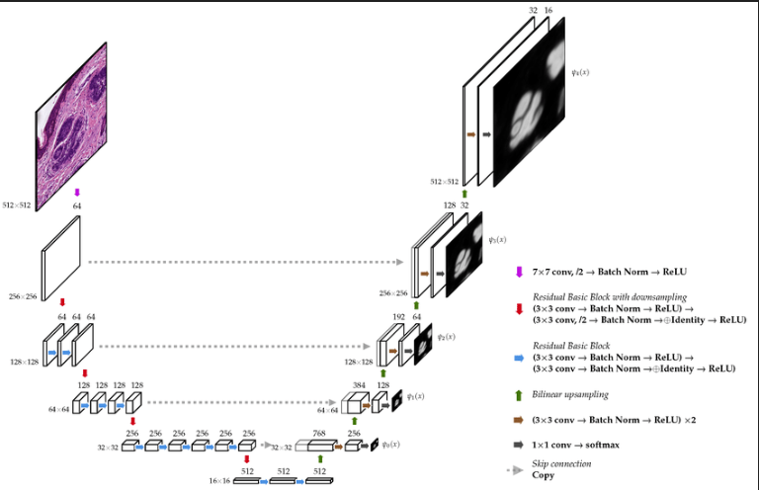
MODEL ARCHITECTURE
U-NET WITH RESNET-34 ENCODER

Slide 7
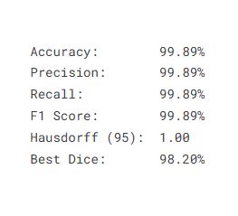
METRICS

Slide 8
Thank you !

